Slide 1
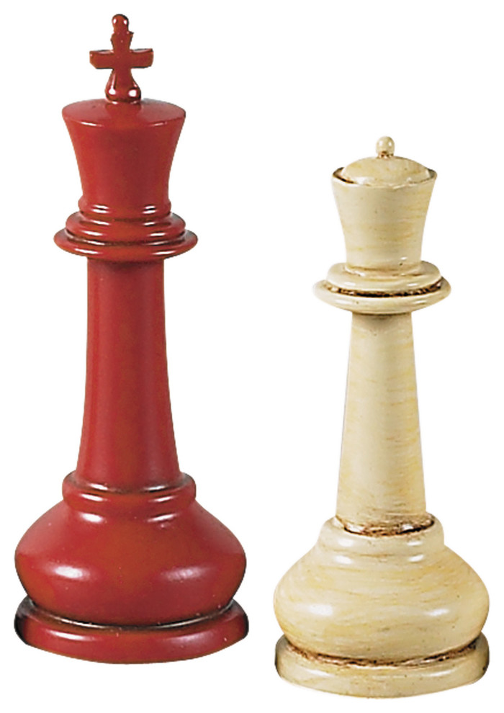
Leadership
Describe, analyse and critique different theories of leadership
Describe, analyse and critique the difference between management and leadership
Describe and critique assumptions management theory and the role of leadership in the learning organisation

Slide 2
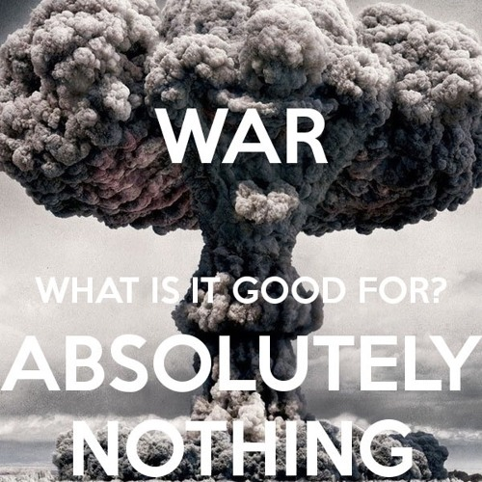
War What is it Good For!
Military leadership describes leadership in terms of the individual’s “Perception” and “Response” to “External reality, the physical and social environment”. Dixon ([1976],1994)
“A senior military or naval commander does not, indeed cannot, act in lonely isolation but is fettered by the organisation to which he belongs.” Dixon ([1976],1994)
Edwin Starr – War, What is it good for? Absolutely nothing!

Slide 3
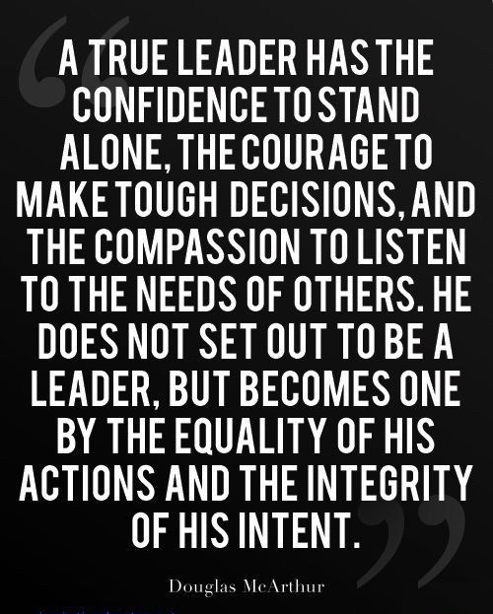
Leadership
Pye (2005) several thousand different definitions of leadership in academic literature. Attempts made to narrow the term to ideas around the core actions of a leader – simple idea that a leader gives direction
Covey (2002)
  Meta leadership – the vision of the organisation. Establishes the direction it is going in
  Macro leadership – focuses on strategy, organisation and process. Works out how the organisation is going to get there
  Micro leadership – relationships, the use of power and how people relate to leadership. How to enable people to work together to make the journey
All three levels of leadership involve change and enabling others to take responsibility for change (Rost, 1991)
Ciulla (2004) argues that ethics is very much at the heart of leadership. There is no value-neutral view of leadership, and any approach or style is built upon values that have to be justified and may well be challenged

Slide 4

Leadership Definitions
The first responsibility of a leader is to define reality. The last is to say thank you. In between, the leader is a servant. —Max DePree
Leadership is the capacity to translate vision into reality. —Warren Bennis
Lead me, follow me, or get out of my way. — General George Patton
Before you are a leader, success is all about growing yourself. When you become a leader, success is all about growing others. —Jack Welch
Leadership is sometimes more apparent by being ineffective rather than by being effective
People both demand and aspire to leadership and it is seen by many as a mark of success to be considered a leader

Slide 5
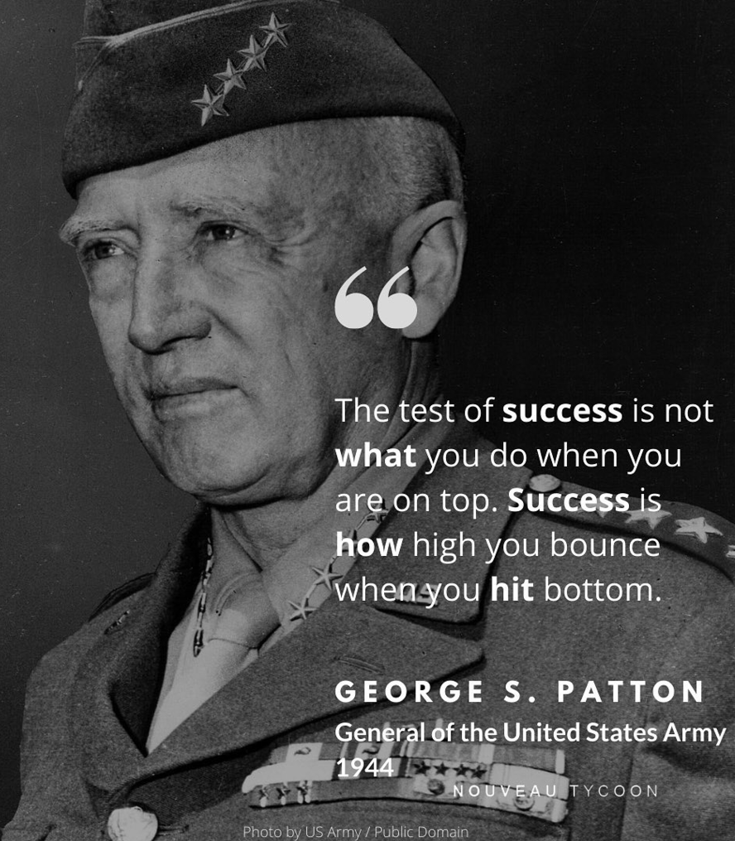
What is Leadership?
Kouzes & Posner (2007:132) - bringing the “leadership vision to life” and describe how, in terms of leadership, this “communication of a vision” increases “job satisfaction, motivation, commitment, loyalty, team spirit, productivity and profitability.”
The leadership vision “about ideals – hopes, dreams and aspirations”
“In the business world, leadership roles tend to be shaped by corporate history and the context of time.” Leavy & McKiernan (2009)
Many leaders possess vision it is the ability to communicate that vision to others that separates the “great and the lesser leaders” (Follett, 1928)

Slide 6

Leadership
The “difference between the great and the lesser leaders, between those who influence their kind abidingly and those who merely mould the clay of present circumstance into the shape of a limited, personal will?” Follett (1928)
Good leaders must have “a tolerance for ambiguity, an ability to hold creative tensions and an ability to care beyond their own personal advantage.” Rohr (2009)
“The difference between effective and ineffective leaders is their mental models or meaning structures, the way they view and deal with their world.” Johnson’s (2008)
Barnard’s ([1938], 1968:272) description of those in executive positions; “Executive positions (a) imply a complex morality (b) require a high capacity of responsibility (c) under conditions of activity, necessitating (d) commensurate general and specific technical abilities as a moral factor; in addition there is required the faculty of creating morals for others.”

Slide 7
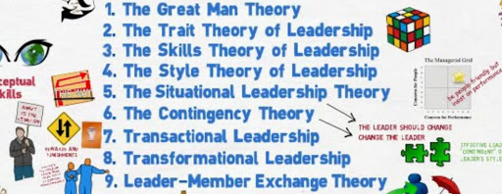
Leadership In Five Minutes https://youtu.be/XKUPDUDOBVo

Slide 8

Trait Leadership
Origins in Hippocrates classification of personality types according to the four ‘humours’
Yukl (1999: 215) Leadership traits;
  Energy level and stress tolerance
  Self-confidence
  Locus of control
  Power motivation
  Achievement orientation
  Need for affiliation
  Emotional stability and maturity
  Personal integrity
Effective leaders are those who have shown high levels of these characteristics
The theory and its associated emphasis on individual leadership may prove important in context

Slide 9
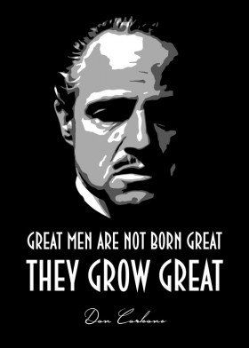
Trait Leadership
Based on two aspects of leadership: the ‘great man’ and the functionalist approach
The Great Man
  Innate capacities that make up the exceptional person, mostly perceived as male, and which enable that person to lead
  Aristotle and Plato - belief that leaders have to be charismatic and of superior intelligence
Functionalist
  Focuses on the core functional capacities
  Functions themselves are often developed in relation to particular views of humanity
McGregor (1960) theories of humanity
  Humanity seen as essentially negative – wishing to avoid responsibility and work. The role of the leader then is to coerce or cajole followers into working
  Human beings as basically positive, and looks to give them as much freedom and responsibility as possible in an organisation

Slide 10

Trait Approach Criticism (Western, 2008)
Lists of common traits are open-ended, what do they actually mean in context?
Focuses solely on the leader and doesn't take the situation into account
Ideas such as dominance, self-confidence, and extroversion feeds into the ‘great man’ myth – the idea that leadership can only be practised by individuals of an elite group
Assumes that leadership involves working with followers who are less able and who must follow their leader
An underlying worldview of individualism and fragmentation
Encourages obedience and not autonomy - raising questions around workplace democracy and what constitutes respect for a workforce
Assumes taking and asserting of power
Can lead to poor ethical decision-making and planning - unaware of the wider environment
Assumes that there is a clear understanding of the role of leadership, and that it is he/she that ensures success
Implies that it is scientific (research on individual business leaders)
Not clear that a generic model can fit many different professional groupings
Context has to relate to a plurality of professions – different leaders may have different perspectives about vision, values and objectives

Slide 11
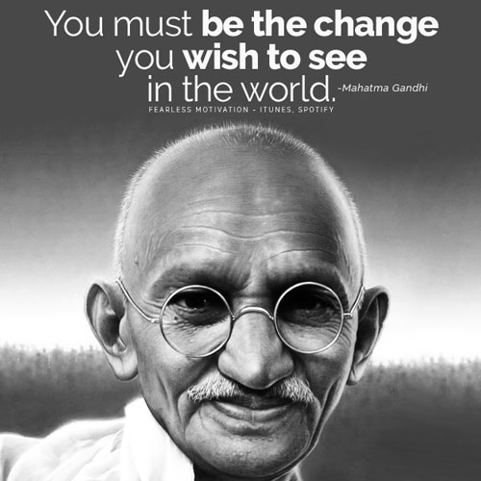
Transformational Leadership (James Burns, 1978)
The leader is essentially moral
Transformational, enabling change and respond to change
Distinguishes transformational from transactional leadership
Transactional leadership
  Primarily about getting the job done
  Values are the means of processes, including responsibility, fairness, honesty, promise-keeping and honouring commitments
  Central are processes that enable the development of consensus (values consensus over purpose)
Transformational leadership
  Focuses on the ends, not the means
  Involves development that can be painful and conflicting
  Not focused on happiness per se or achieving agreements that compromise core values
  The ends in question are key moral ends that transcend the interests or purpose of any particular group
  Includes justice, freedom, and equality (universal principles for the greater good)
Gandhi – core values of freedom and equality, and provided the basis for collective purpose that could be shared

Slide 12
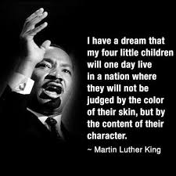
Transformational Leadership
The leader enables people to develop moral maturity
Linked to Kohlberg’s stages of moral development
Associated with moral maturity and leaders are better able to make decisions around value and purposes
Focus on values and rationality
  Better able to receive and take in the widest possible data, different perspectives of that data and different possible options
  Thus leading to better leadership decisions in turn, leads to a better, effective and responsive organisation
‘Looks for potential motives in followers, seeks to satisfy higher needs, and engages the full person of the follower’ (1978: 20)
Enables members to develop into responsible leaders, becoming fully moral agents
Can cause both organisational and societal change - social responsibility is a key part of the identity of the organisation

Slide 13
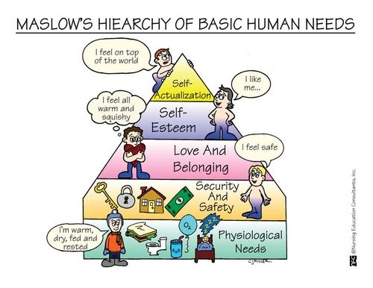
Transformational Leadership
Maslow’s hierarchy of needs, stressing the primacy of core physical needs, argues that the leader must address the basic needs first. Essential if the higher-level social needs of the followers, including social identity and self-actualisation, connected ultimately with higher values, are to be met
Leadership Traits;
  Expand the followers’ understanding and profile of needs
  Transform the followers’ view of self-interest: enables followers to see that concern for others is a key part of their own interest
  Increase the confidence of the followers
  Elevate the expectations of followers
  Enable a fuller appreciation of the leader’s intended outcomes
  Enable behavioural change motivate followers to higher levels of personal achievement, seen in terms of Maslow’s self-actualisation

Slide 14
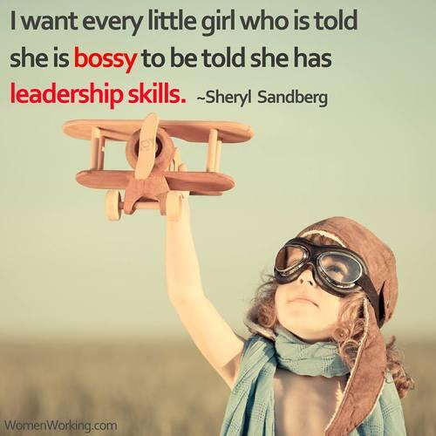
Authentic Transformational Leadership (ATL)
(Bass & Steidlmeier)
Idealised Influence
  Charismatic, centred on universal values –v-pseudo-transformational leadership - grandiose visions and aggrandisement
Inspirational Motivation
  Centres on positive values, such as harmony and altruism –v- focus on fear, defence and insecurities (false Messiahs)
Intellectual Stimulation
  Involves an ‘open architecture dynamic’ into vision, evaluation and implementation
  Encourages critical conversation and debate around vision and practice (spirituality)
  Emphasis on rational reflection - all can rationally defend the values
  Pseudo-transformational leadership is not tolerant of critical conversation, and does not get involved in developing the intellectual capacity
Individualised Consideration
  Focuses on how the individual can develop, involving coaching and mentoring
  Involves enabling followers to develop as leaders
  Contributions to the organisation as a whole and ways in which the individual could represent the organisation beyond its boundaries (CSR) –v- dependence of the followers, child–parent relationships that discourage autonomy (self-governance)

Slide 15
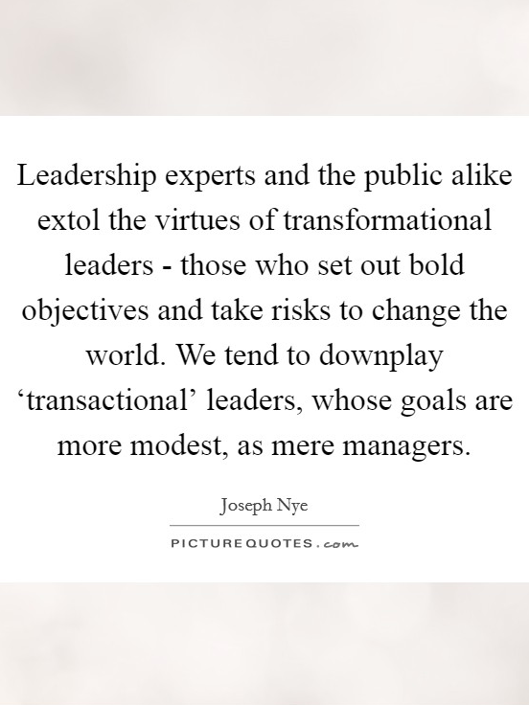
Transformational Leadership Criticism
Should leaders create a vision that will transcend the interests of the individual?
  Keeley (2004) - successful leaders reflect the many interests & values of different stakeholders - effective listening was more important than communicating a vision
  Stakeholder theory - all organisations have to deal with different stakeholders and views about the values and purpose of the organisation and beyond
  Should leaders be striving to change values? Change is a given and is often imposed on the organisation
  Charisma is not necessarily central to leadership. Can subvert the capacities in lower management by diminishing their responsibility and authority
Rigid distinction between transactional and transformational values - dominated by transformational values
Transactional values are significant
  Values of fairness, responsibility, trust and promise-keeping, - central to the higher moral project (Kant). Fairness, relates directly to justice (Rawls, 1971)
  Not just self-interest - may involve the negotiation and development of responsibility, that works through higher, general, values and principles in practice
Does not genuinely respect the autonomy of followers
  Keeley (2004), assumes collective ends are more legitimate/morally powerful than individual ends
  Paternalist relationship: leader knows the core values and has to communicate them to followers, who are not aware of them and develop awareness (prophet & messiahship)
  But who is to say what the core values are? Western (2008) imposes values and the engineering of culture (imposing is charismatic, individualist and elite leadership model)
Enteman (1993) argues, that at any time different moral values may take precedence, involving such imperatives as the sustainability of the firm and of related stakeholders

Slide 16

Servant Leadership
Frodo Leading
Despite other strong ‘leaders’ such as Arwen, Gandalf, Aragorn and Boromir
LOTR The Two Towers - The Tales That Really Mattered...
https://www.youtube.com/watch?v=k6C8SX0mWP0

Slide 17

Servant Leadership
Closely related to the transformational approach
Greenleaf (1977) - Herman Hesse’s Journey to the East (2003)
  Central is Leo, a servant who carries the bags and does all the essential chores. Over time it becomes evident that Leo gives to the group a sense of coherence and well-being. When he inexplicably disappears, the group loses its coherence and direction. Becomes clear that Leo was in fact the leader of the group
Ciulla (2004: 71) - simple but radical shift, principally as it questions the paradigm of leaders and follower - leaders take the function often associated with followers – that of servant
Marks it out from the prophet and messiah idea
Involves putting the needs of those who are being led first
Christian paradigm: stresses Christ’s servanthood (Gospel of Mark 8:27–30)
Mindset change ‘an understanding and practice of leadership that places the good of those led over the self-interest of the leader’ (Laub, 2004: 5)
Moves away from a concern with organisational and customer interests - not unimportant, but peripheral
Group and member changes will emerge with the focus on the followers
Alimo-Metcalfe and Alban-Metcalfe (2005) argue the importance of providing empirical research - assessment of leadership beyond task fulfilment and into monitoring whether real service has been achieved

Slide 18
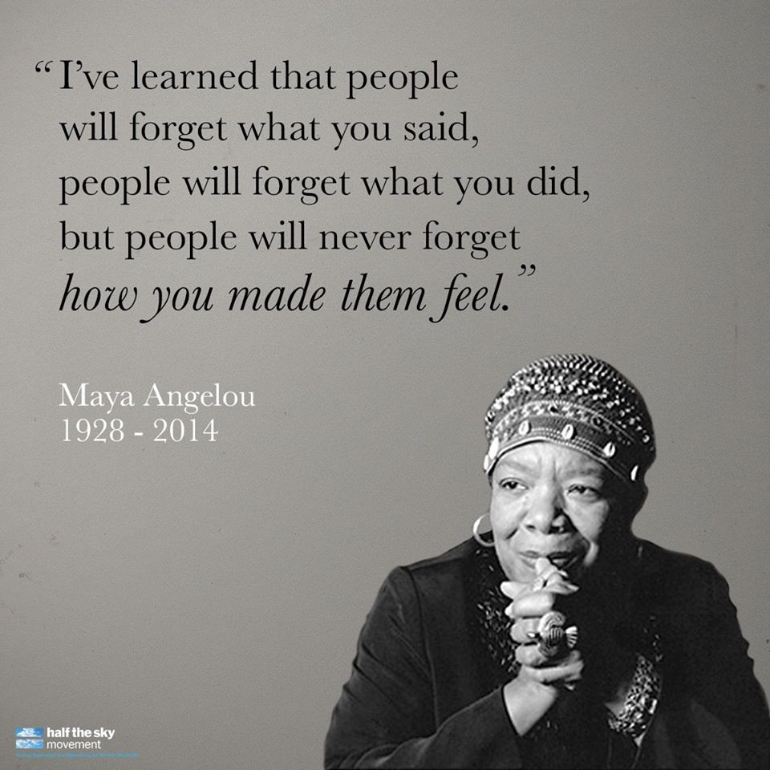
Servant Leadership
Six key behaviours (Laub,2004)
  Valuing people
  Developing people
  Building community
  Displaying authenticity
  Providing leadership
  Sharing leadership
Greenleaf (1977) - ten core characteristics - listening, empathy, healing, awareness, persuasion, conceptualisation (the capacity to develop a vision), foresight (the capacity to understand and learn from the past, and apply these lessons to the present and future), stewardship, commitment to the growth of people, and building community.
Ethically the idea goes beyond the universal principles of Burns based on altruism and care, virtue ethics, and a worldview of stewardship

Slide 19
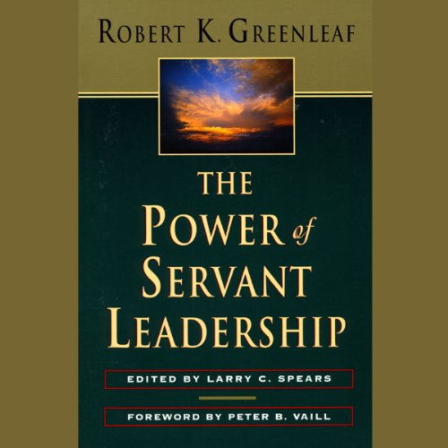
Servant Leadership Criticism
Polleys (2002) - no theoretical base and it is not possible to build any theory
  Based in values and a particular worldview
  Empirical research has aimed to provide support for the model in practice, criticisms that it is not practical in the context of leadership that demands difficult and swift decision-making
Lack of theory makes it difficult to provide a substantive analysis - leads to a view that is based in a strong ethical principle (Service). Ultimately, the idea of service requires at least some idea of the good being served
The good behind the idea of service is best expressed in the concept of agapē, unconditional care in the Christian tradition but, historically, women became oppressed by models of unconditional service (Robinson, 2001)
Emphasis on care and service can lead to polarised and imbalanced ethics
Too great a stress on altruism, to the exclusion of self-interest

Slide 20
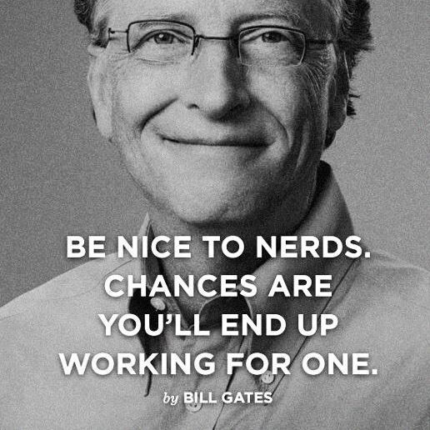
Transactional Leadership Rost (1991)
Attempts to balance the different ethical elements
Contrasts influence with institutional authority
Influence is multi-directional; authority is top-down with one direction. Influence is based on persuasion, not coercion. Requires several things
  Effective contractual relationships, involving acceptance of responsibilities legitimated by contract
  Followers are active, not passive
  Subordinates, empowered by contract multiple leadership, varying in different contexts.
  Active followers have many roles that are dynamic, part of a complex system, not a fixed hierarchy
  Accepts that organisations may have several different purposes - leads to constant interactive relationships, responding to change
Accepts leadership involves transformation of some kind

Slide 21
Transactional Leadership (Rost,1991)
Contract & Negotiation
Maintains autonomy and integrity among all the parties
Highlights power relations among people of unequal power and different agendas
Followers are significantly involved in negotiation that results in a decision/action
Acknowledges that followers can influence the leader
Social system with mutual feedback between leaders and followers
A contract can develop equality and freedom
Protects the individual from coercive or abusive leadership (negative freedom)
Enables members to develop a voice (positive freedom)
However, the contract can be negative and oppress the follower and discourage initiative
Has to have elements of the transformational approach: leaders & followers working through core values in practice

Slide 22
Adair’s Action-Centred Leadership Model
Task Needs
Defining the task
Making a plan
Allocating work & resources
Controlling quality & tempo of work
Checking performance against plan
Adjusting plan
Team Maintenance Needs
Setting standards
Maintaining discipline
Building team spirit
Encouraging, motivating, giving sense of purpose
Appointing roles
Ensuring communication within the group
Individual Needs
Attending to personal problems or issues
Valuing individuals
Recognising & using individual abilities
Training / helping the individual

Slide 23
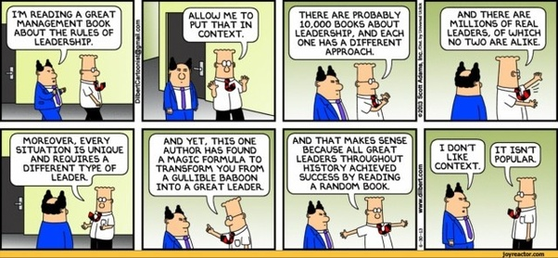

Slide 24
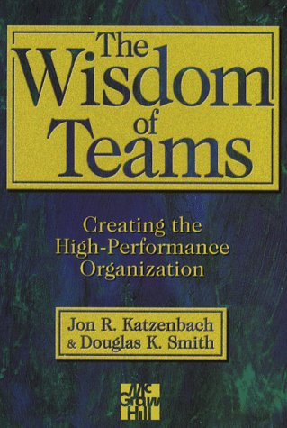
The Following Part of Leading
Providing opportunities for others to lead you
This goes beyond the traditional notion of looking for growth opportunities for other people
Unless the opportunity in question bears a real risk for your personal performance outcome, you are not actually positioning yourself as a follower
Katzenbach, J. & Smith, D. (1994) The Wisdom of Teams, New York: Harper Business.

Slide 25

The Following Part of Leading
Asking questions instead of giving answers
By asking such questions such as "What do you think we should do?" or "How do you suggest we proceed?" you take a step behind another person. Whether you stay behind, of course, depends on your intention to actually follow the suggestion or answer of that other person.
Katzenbach, J. & Smith, D. (1994) The Wisdom of Teams, New York: Harper Business.

Slide 26
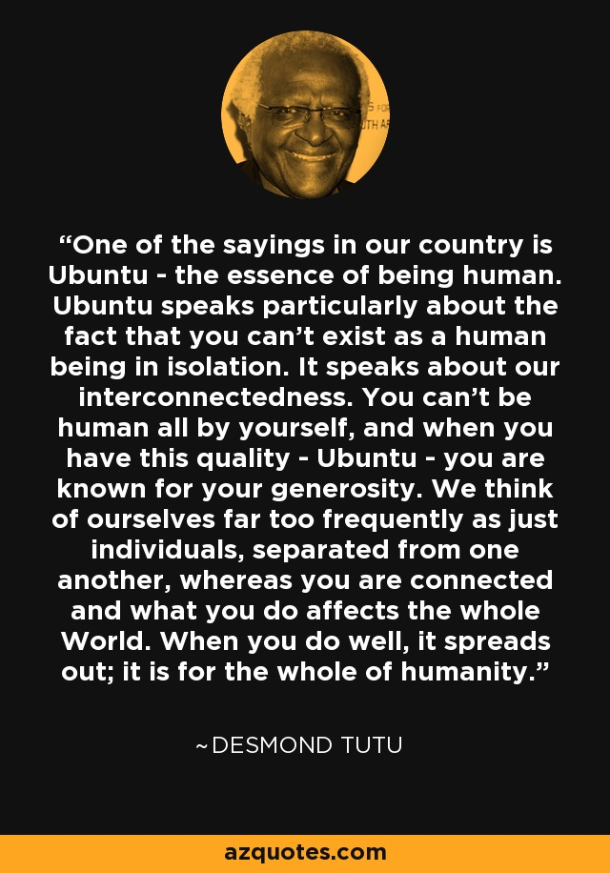
The Following Part of Leading
Doing real work in support of others instead of only the reverse
Rolling up your sleeves and contributing "sweat equity" to the efforts and outcomes of other people earns you their appreciation as someone upon whom they can depend, regardless of the relative hierarchical or functional position each of you holds

Slide 27
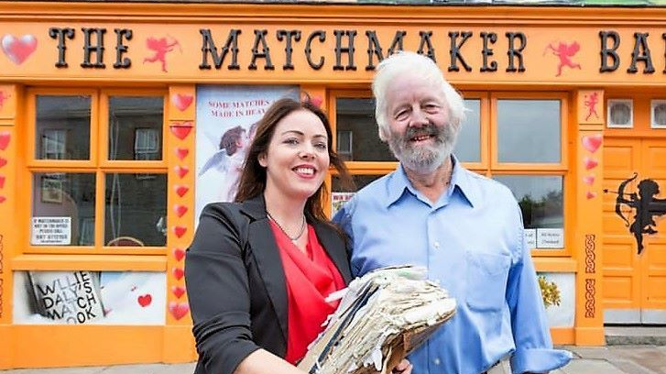
Matchmaker
Becoming a matchmaker instead of a "central switch"
In addition to following other people yourself, you must learn to help them follow each other
This requires you to get beyond considering yourself the "central switch" through which all decisions flow
Instead, you need to look for every possible chance to help people find their best collaborators. "Have you asked Sally or Rasheed what they think?“
Is often the only input required to facilitate the effort at hand, although you then must submit your effort and support to whatever the people in question suggest
Willie Daly (Matchmaker)

Slide 28
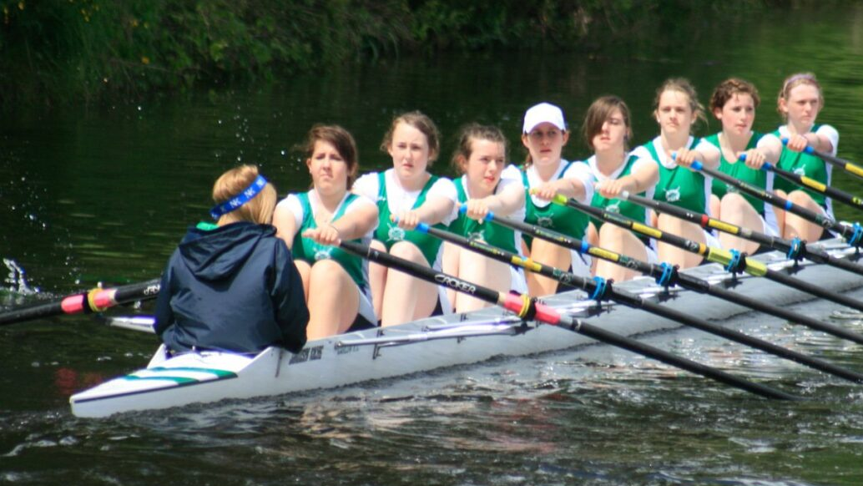
Common Understanding
Seeking common understanding instead of consensus
The pejorative meaning associated with consensus management has nothing to do with either effective leading or effective following
Leaders who know when and how to follow build deep common understanding, not superficial consensus, around the purpose, goals, and approach at hand
They submit themselves and others to the discipline of ensuring that all sides to any disagreement are fully understood by everyone, recognizing that mutual understanding is far more powerful than any particular decision to choose path A over path B
All people will follow strong, commonly understood purposes and goals more easily than the "put-up jobs“ associated with consensus

Slide 29

Individual Performance
As a leader, you must follow another individual, regardless of hierarchy,
If that individual, through experience, skill, and judgement, knows best
That individual's growth demands that you invest more in his or her skill and self-confidence than in your own
Only that individual, not you, has the capacity (the time and opportunity) to "get it done"

Slide 30
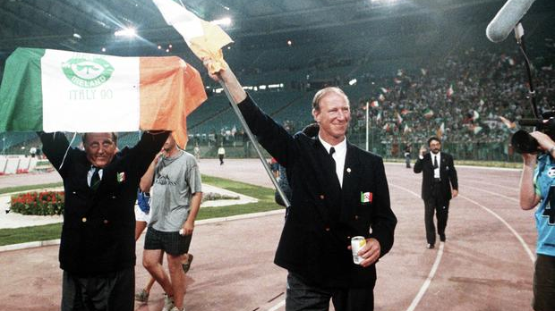
Team Performance
As a leader, you must follow the team if:
    The team's purpose and performance goals demand it
    The team, not you, must develop skills and self-confidence
    The team's agreed-upon working approach requires you, like all the others, to do real work
    Jackie’s Army “Put them under pressure” https://www.youtube.com/watch?v=I5PT65I2ny8

Slide 31

Organisational Performance
As a leader, you must follow others, regardless of hierarchy, if:
    The organisation's purpose and performance goals demand it
    The need for expanding the leadership capacity of others in the organisation requires it
    "Living" the vision and values enjoins you to do so

Slide 32

Review of Leadership Theory
Foundations in sociology, psychology, sport, and politics
Views leadership as a process that is diffuse throughout the organisation
Emphasis is on developing ‘leaderful’ organisations with a collective responsibility for leadership rather than developing the ‘individual’ leader

Slide 33
Leadership Skills & Traits (Stogdill, 1974)
Skills
Clever
Conceptually skilled
Creative
Diplomatic
Fluency
Knowledgable
Organised
Persusive
Social
Traits
Adaptable
Alert to social environment
Ambitious
Goal oriented
Assertive
Cooperative
Decisive
Dominant
Energetic
Persistent
Self-confident
Resilent
Willing to assume responsibility

Slide 34
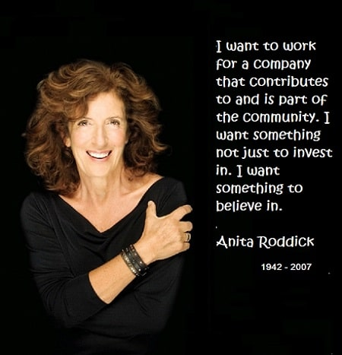
Anita Roddick
Responsible leadership that held together the different modes of responsibility
Leadership Characteristics;
Constantly used narrative
  The base for developing meaning and exemplifying virtues
  Enabled ownership of identity, and good models of developing meaning & practice, taking account of feelings, core ideas & values
  “Words create the world. You’ve got to have a language of socially responsible business” (Wittgenstein)
Development of networks
  Responsible leadership dispersed through stakeholder management
  Management was built around building and sustaining moral relations with stakeholders
  Focused on justice, accountability, and the broadest view of responsibility, seen in economic, ecological, social, political and human responsibilities
Vision of a culture of global citizenship
  Integral part of doing business
  Stakeholders would take responsibility, and so become leaders
  Dispersed leadership, not just for followers but for all stakeholders
Asserted the need to place responsibility at the heart of the curriculum and staff development (Pless,2007)

Slide 35

Mission Statement ‘Reason For Being’
To creatively balance the financial and human needs of our stakeholders: employees, customers, franchisees, suppliers and shareholders
To courageously ensure that our business is ecologically sustainable: meeting the needs of the present without compromising the future
To meaningfully contribute to local, national and international communities in which we trade, by adopting a code of conduct which ensures care, honesty, fairness and respect
To passionately campaign for the protection of the environment, human and civil rights, and against animal testing within the cosmetics and toiletries industries
To tirelessly work to narrow the gap between principle and practice, while making fun, passion and care part of our daily lives
(Body Shop International.com, 2004)

Slide 36

Transformational Learning
Mezirow (2006:24) describes transformational learning as a concept
“recognition of a critical dimension of learning in adulthood that enables us to recognize and reassess the structure of assumptions and expectations which frame our thinking, feeling and acting
These structures of meaning constitute a ‘meaning perspective’ or a frame of reference.”

Slide 37
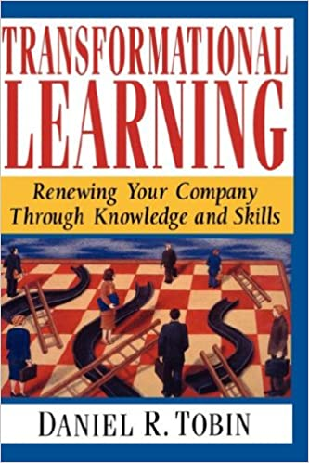
Transformational Learning
According to Mezirow ([2009],2010:94) a result of transformational learning “may be epochal – sudden major transformations in habit of mind, often associated with significant life crises – or cumulative, a progressive sequence of insights resulting in changes in point of view and leading to a transformation in habit of mind.”

Slide 38
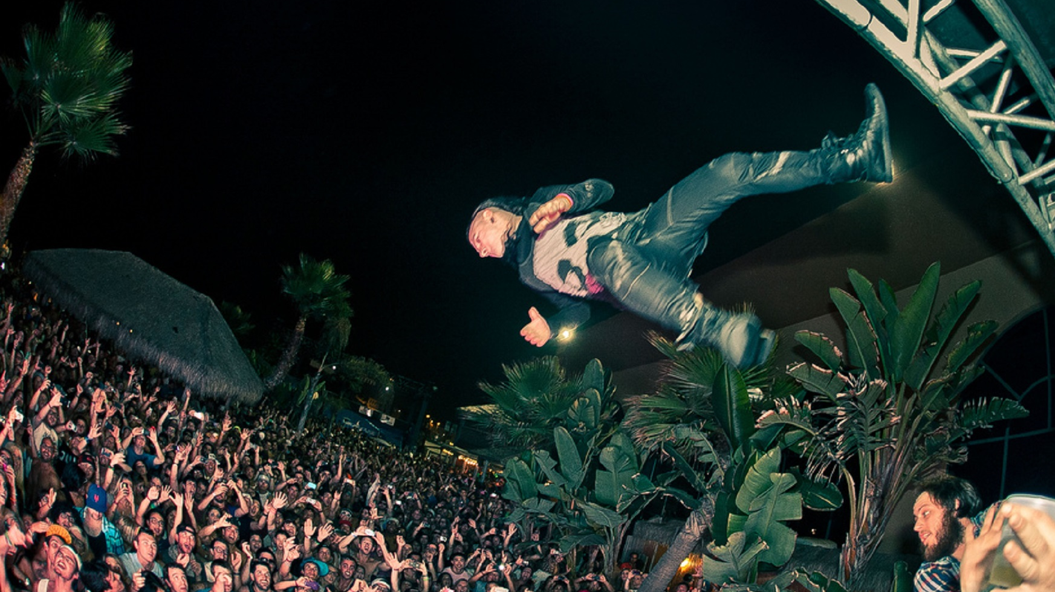
Big Assumptions
In the context of ‘transformational learning’, Mezirow et al (2000:337) write of the need to uncover “big assumptions” which is something, we hold as a truth, rather than an assumption, so that our assumptions hold us rather than we hold the assumptions.
Kegan & Lahey (2001:80) describe, the ‘big assumption’ as “not something you look at but something you see through, your lens on the world.”
The tenet of the ‘big assumption’ along with the ‘competing commitment’ is central to Kegan & Lahey’s (2001) work
Discovering and identifying our ‘big assumptions’ is an important step in the process of ‘transformative learning’.
Drucker’s (1993:5) term “intellectual arrogance” is one example of a ‘big assumption’ and his term “disabling ignorance” describes the effect of being ‘subject to a big assumption’

Slide 39
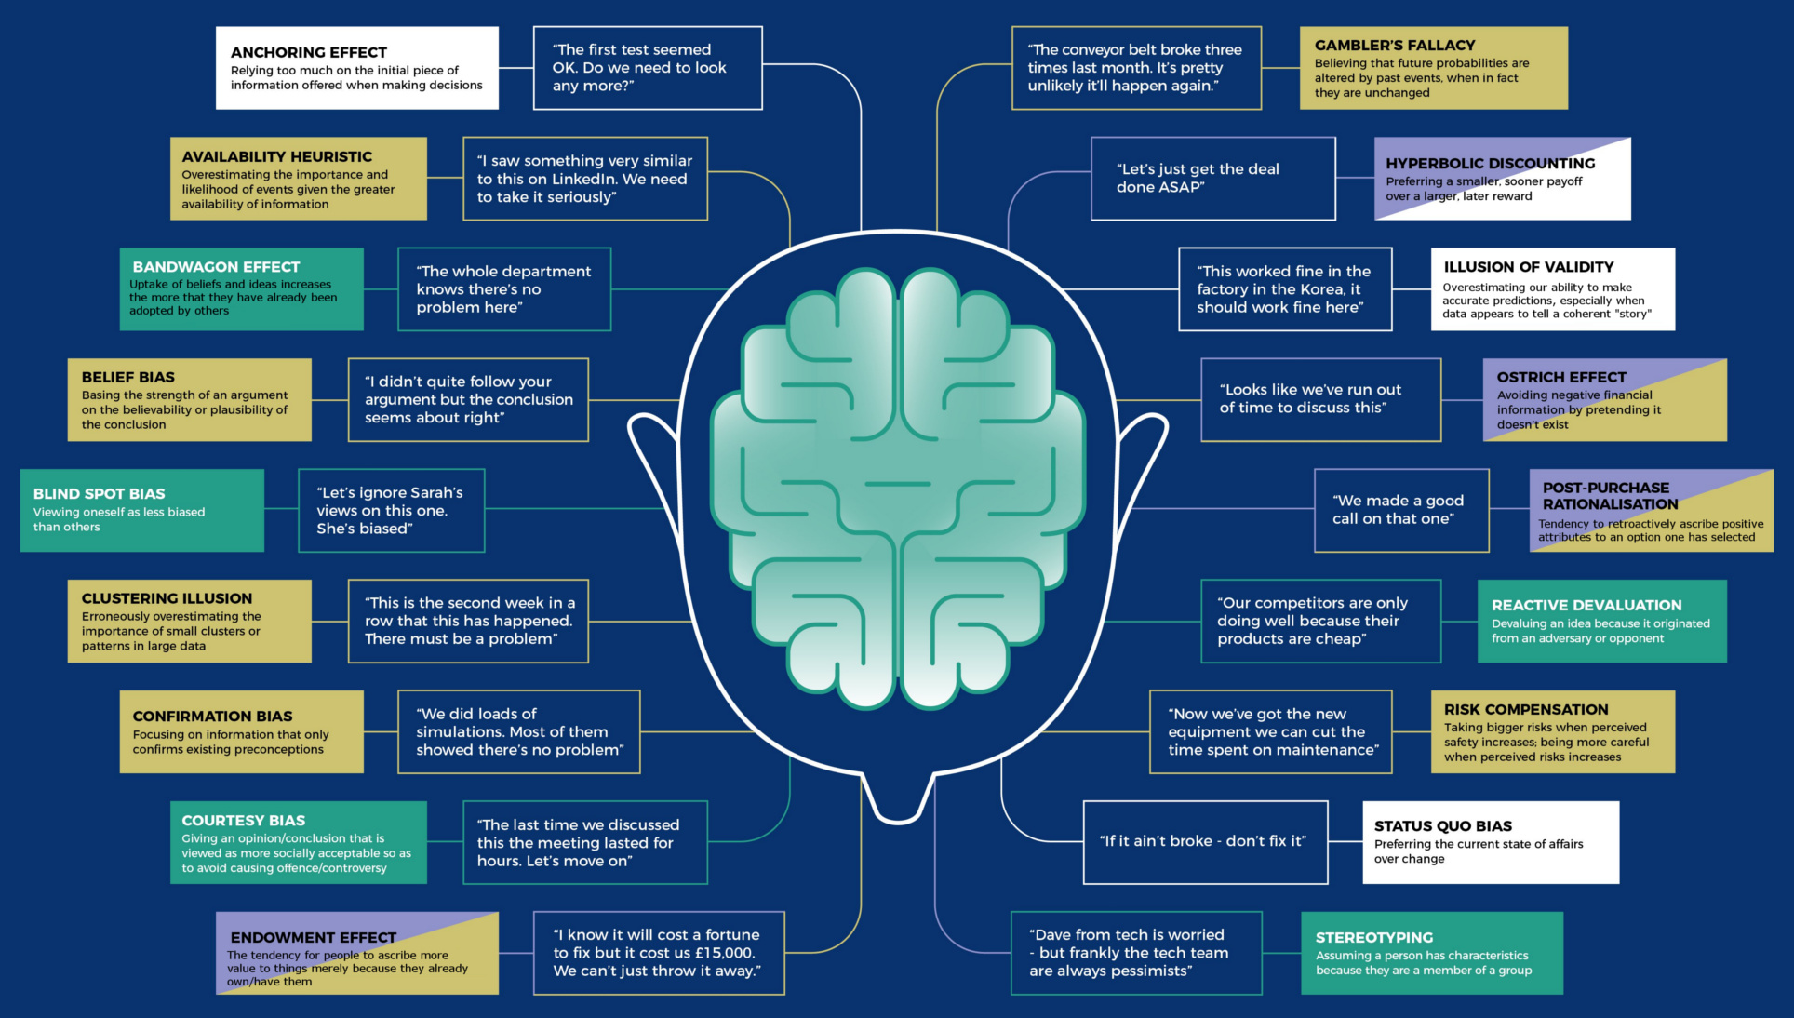
Forms of Bias
Contrast bias
Reciprocation bias
Commitment bias
Social proof bias
Liking bias
Authority bias
Scarcity bias
Ease of recall bias
Information bias
Chance bias
Relationship bias
Overconfidence bias
Hindsight bias
Status quo bias
Sunk cost bias

Slide 40
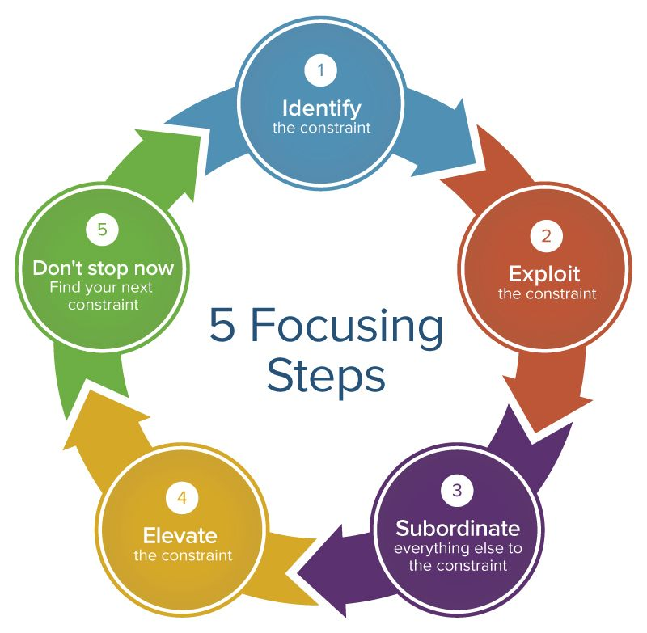
Constraint
In many ways, the ‘big assumption’ is a constraint, identified by Goldratt (1984) as an element of his Theory of Constraints
While Goldratt is writing from an industrial perspective and considers constraints as both tangible and intangible, tangible constraints include plant and machinery while an intangible constraint is the mental-model of management
It is interesting to note that Goldratt is founder of TOC for Education, which is an organisation, dedicated to implementing TOC theory as a tool for education

Slide 41
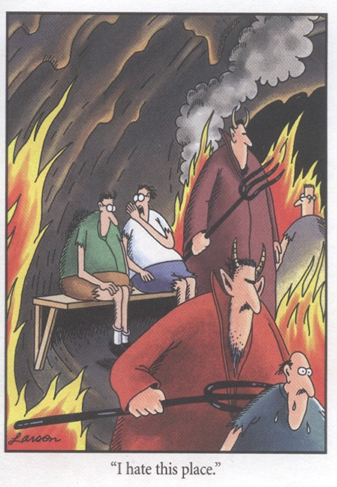
Attitudes
Discussing the implications of education, Gagne (1977:240) posits,
  “If attitudes are to be established or changed, they must be identified as learning outcomes and as instructional objectives. For such purposes, a useful definition of attitude is a learned internal state that influences choices of personal action toward some category of persons, objects or events.”
The influence of ‘a learned internal state’ is an apt description of a ‘big assumption’?

Slide 42

Leadership
Rohr (2009:156) “we can set aside our own mental constructs”
These ‘mental constructs’ can be considered in terms of our own personal theories and are similar to Kegan’s ‘big assumption’. In order to develop we need to examine our theories (our ‘big assumptions’), our way of viewing the world, and through learning set these aside when they no longer serve.
Rohr (2006:156) lists “some insights into what every good, nondual leader knows and practices”.
Rohr (2009:156) asserts that good leaders must have “a tolerance for ambiguity, an ability to hold creative tensions and an ability to care beyond their own personal advantage

Slide 43
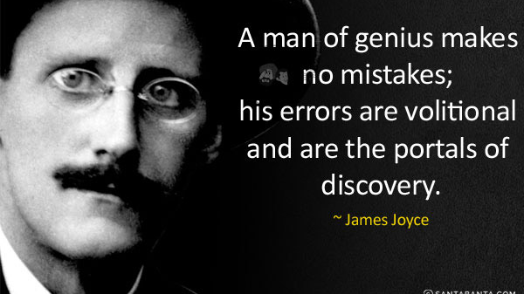
Cognitive People
The process of self-examination has a resonance with Tierney (2011:10) who describes such self examination in terms of James Joyce’s metaphor of “sideways glimpses”, which she describes as, “glimpsed observations of self in the process of the enquiry, together with an account of the ways in which I have both influenced and been influenced by this enquiry”.

Slide 44
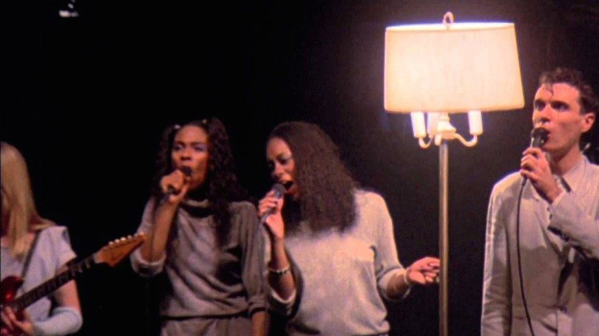
Making Sense?
My meaning-making system - what is this?
Is it a theory, a set of theories, a set of values or a set of beliefs?
Talking Heads – Stop Making Sense

Slide 45
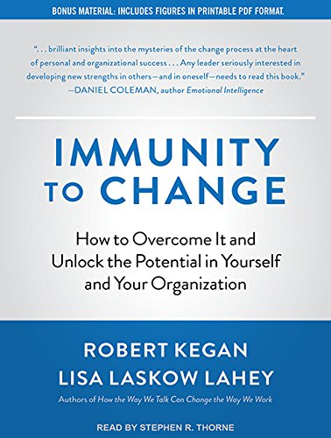
Making Sense?
Examination of the meaning-making system is a difficult task; Kegan’s (2001:78), four-column conceptual map presents a tool to address this task but only in terms of the current situation.
Kegan (2001:76) describes the as a “conceptual map of your mental machine, your new technology for learning.”
It is a mechanism, which enables the individual to map their “immunity to change”
Kegan (2001:6) describes ‘immunity to change’ in terms of something that holds us captive
He goes on to further describe (2009:xi), ‘immunity to change’ in terms of “hidden motivations and beliefs that prevent” people “from making the very changes they know they should make and very much want to make”.

Slide 46
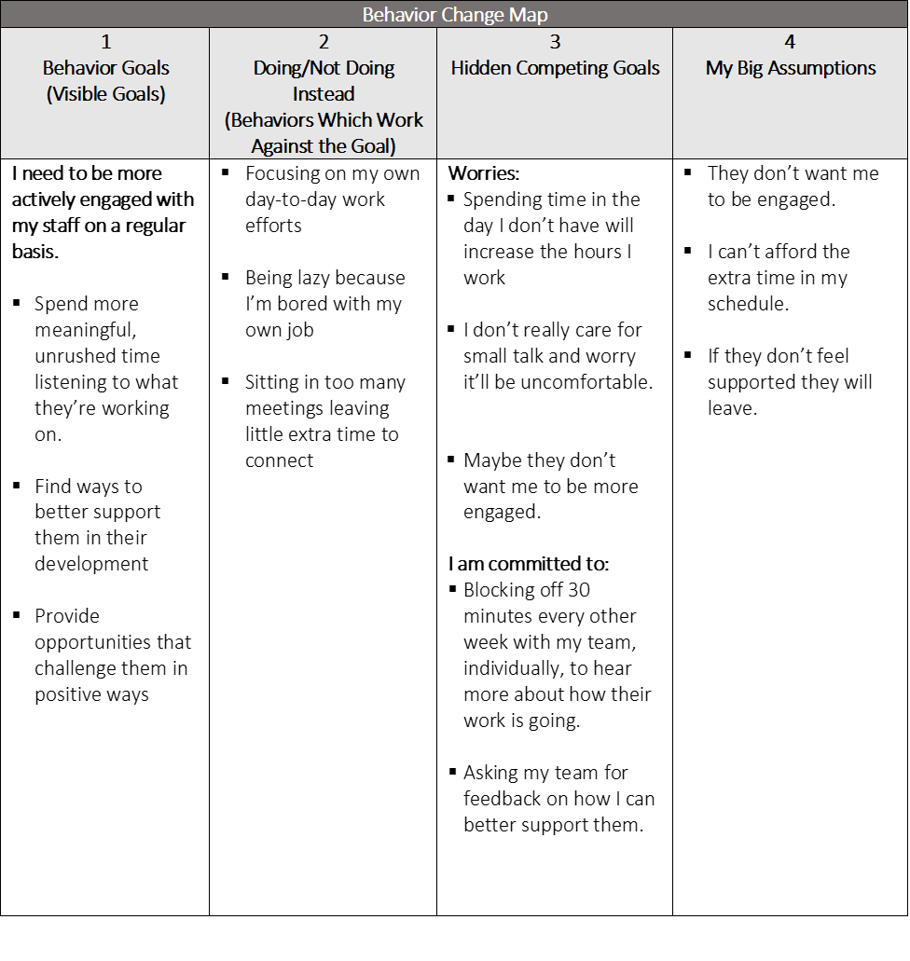
Uncovering the Big Assumption
In column one, the individual lists a commitment, a goal they wish to attain
Column 2 details the behaviours, which prevent the commitment being fully realised
Column 3 lists the competing commitments, which disrupt or prevent attainment of the goal
Column Four lists the ‘Big Assumptions’, it is this detailing of the ‘big assumption’ which Kegan (2001:74) describes as taking “us into highly consequential, decidedly nontrivial territory.”
The big assumption is something he (2001:74) describes as holding “sway over us.” It prevents us from doing something.
The identification of the ‘big assumption’ enables the individual to understand, analyse and overcome it
Adapted from Kegan & Lahey (2001:78)

Slide 47
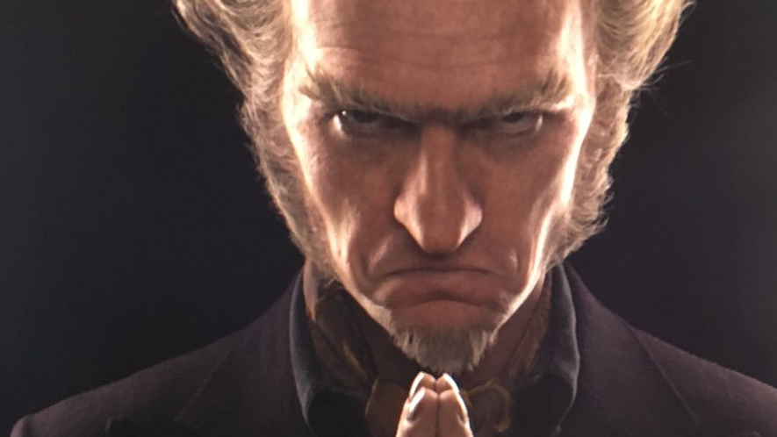
Assumptions
Drucker (1994:99) prescribes constantly test the theory of the business in terms of assumptions about the environment of the organisation:
    Society and its structure, the market, the customer and technology
    Seeks to improve in all areas
Assumptions are dangerous things to make, and like all dangerous things to make - bombs, for instance, or strawberry shortcake - if you make even the tiniest mistake you can find yourself in terrible trouble”. Count Olaf - The Austere Academy

Slide 48
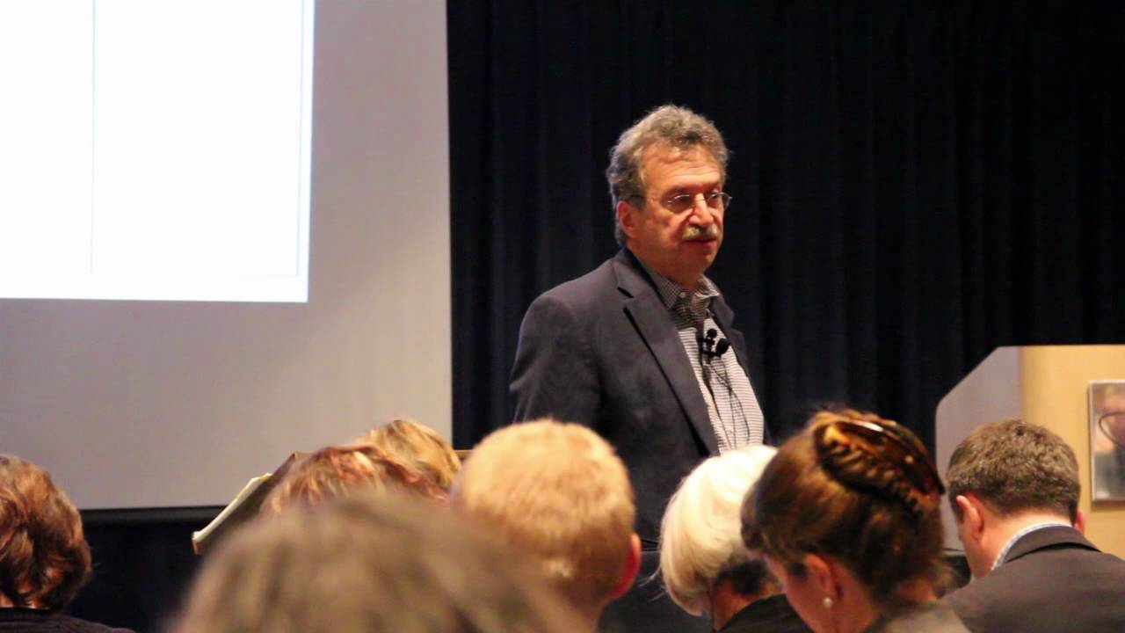
An Evening with Robert Kegan and Immunity to Change https://youtu.be/FFYnVmGu9ZI

Slide 49
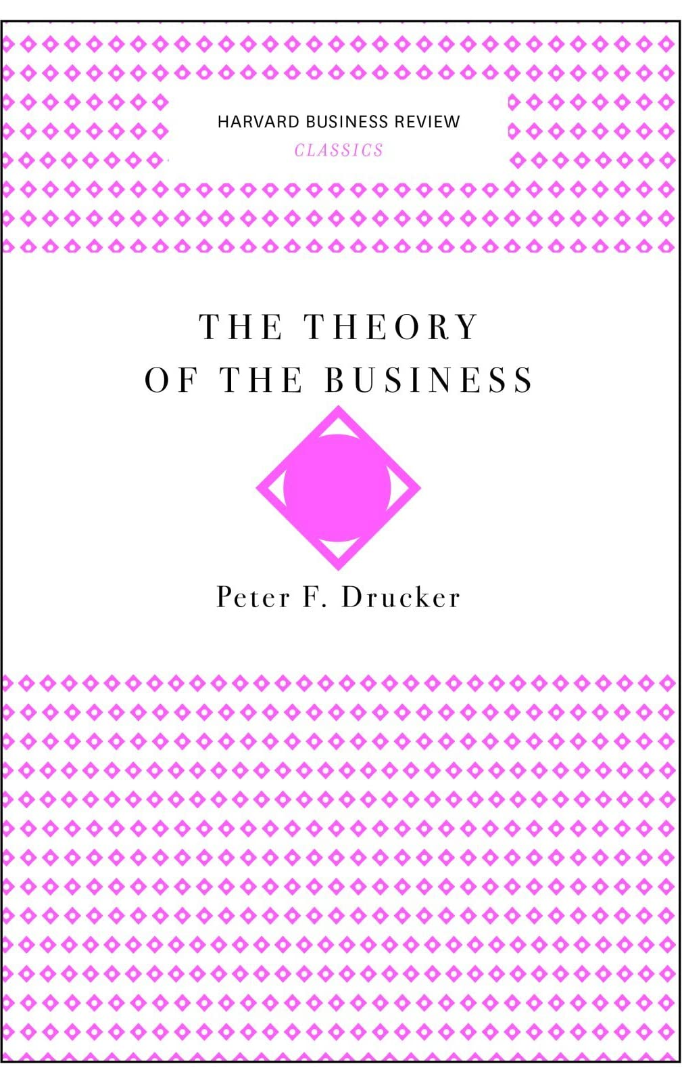
Theory of the Business
Drucker (1994:95) defined the “theory of the business” as “what to do” particularly in the context of a firm, that has “enjoyed long term success”
Consists of a “set of assumptions” that shape any organisations behaviour, dictate its decisions about what to do and what not to do, and define what the organisation considers meaningful results
These assumptions are about
    Markets
    Identifying customers and competitors, their values and behaviour
    Technology and its dynamics
    A company’s strengths and weaknesses
These assumptions are about what a company gets paid for – “a company’s theory of the business.” Drucker (1994:96)

Slide 50

Assumptions
Drucker (1994) highlights the influential role of assumptions on the performance of the firm
Likewise, Kegan & Lahey (2001, 2009) examine the role of assumptions in relation to the individual and their personal development
An assumption is something, which is taken for granted by an individual, group, or organisation
Assumptions form part of the meaning-making system and are comprised of a system of personally authored values and principals
They are something, which are believed to be true to such an extent that they can govern behaviour and decision-making.
“Assumptions-taken-as-true have the quality of universal generalisations, which we all know are supposed to be disprovable by even a single counterinsurance.” Kegan & Lahey (2001:83),
It is something, which Kegan & Lahey (2001) describe us as being ‘subject to’
In the terminology of Goldratt (1984), an assumption can be ‘a constraint’ in the meaning-making of a firm or an individual.

Slide 51
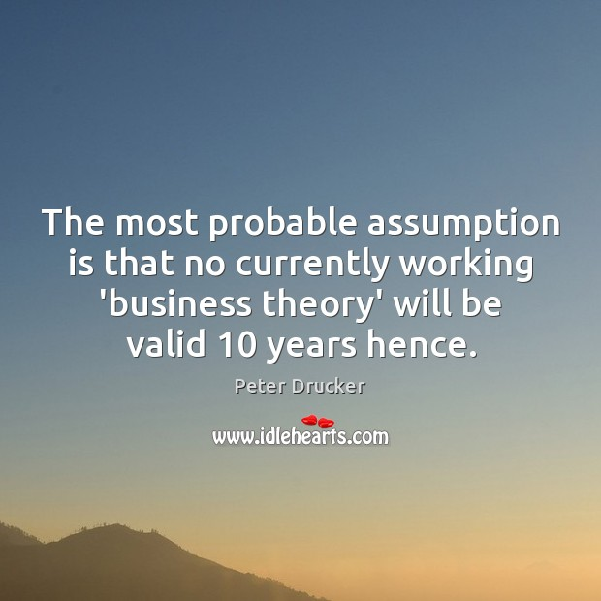
Examine Assumptions
Drucker (1994) and Kegan & Lahey (2001, 2009) provide a mechanism to examine assumptions and their role in relation to progress
Torbert et al (2004:14) emphasise the need to test assumptions, “Many of the day-to-day frustrations of work life can be avoided by brief assumption-testing action inquiries.”
However, they point out that “checking and inquiry are rare in business, professional and familial conversations.”

Slide 52


Slide 53

Creativity
Extraordinary ideas are or achievements are not necessarily the results of extraordinary people’ Weisberg (1986)
‘Creativity is the act of making new relationships from old ideas’ Koestler (1964)
‘Creativity is the ability to look at things differently’ Keil (1987)
90% of entrepreneurs start their companies in the same marketplace, technology or industry they have been working in ’ Timmons (1999)

Slide 54

Creativity
Discovery
  Is the result of a careful methodical approach to seeking new ideas or alternative solutions
Invention
  Is the solution / outcome to a problem, very often a technical one
Innovation
  Is a process whereby new ideas are put into practical use to add value commercially
Opportunity
  A business concept, that if turned into a tangible product or service, will result in financial profit

Slide 55

You…
What’s your idea?
What’s the problem?
Where does your idea fit?
Who’s your customer?
What’s your path to market?
Where’s the money?
What’s your competitive edge?
Who’s on your team?
What’s your story?

Slide 56
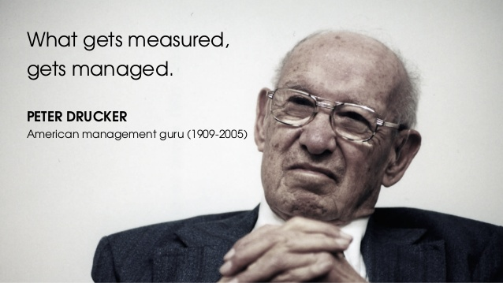

Slide 57
Ethical Leadership
Peter Senge (1990)
Dispersed leadership
Focus on the capacity of the organisation to learn
Genuine learning organisation looks to enable a continued reflection between its vision and reality
Importantly, leadership becomes more a function of stewardship: leaders are not focused on absolute control but rather on enabling the organisation to be accountable and aware of the social and physical environment
The leader enables the ethical tone of the corporation
Trevino and Brown (2004)
How the leader enables ongoing reflection on core values and purpose
Contrast with unethical managers who set out high values but in fact practise deceit
‘Ethically silent’ managers who reveal no moral understanding -problem is that no behaviour is ethically neutral
Tawney (1930)
All behaviour, especially decisions, embodies value and thus indicates an ethical position
The ethical leader is to help the organisation think about, articulate and test ethical values, and to embody the core virtues that enable this
Embodies core values
For the leader who does not make ethics clear runs the risk of ethical and organisational confusion

Slide 58
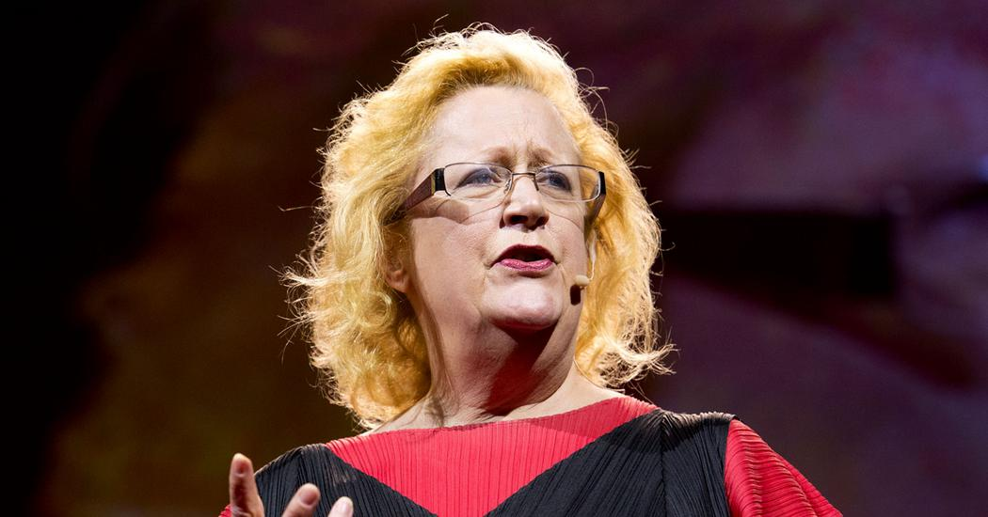
Margaret Heffernan – Dare to Disagree
https://www.ted.com/talks/margaret_heffernan_dare_to_disagree#t-39239

Slide 59
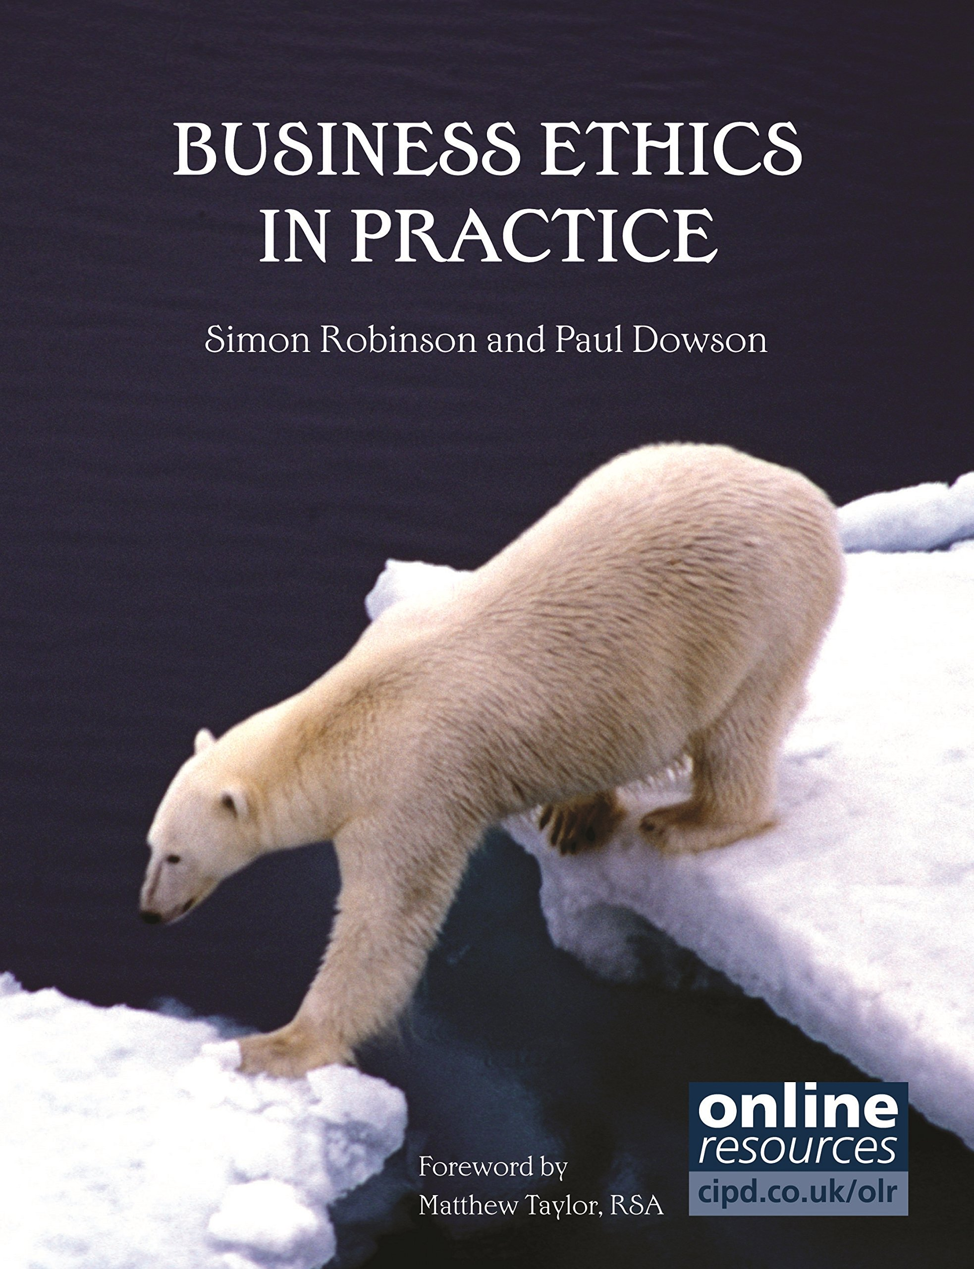
References
Alimo-Metcalfe, B. and Alban-Metcalfe, J. (2005) ‘Leadership: time for a new direction’, Leadership 1: 51.
Burns, James. (1978) Leadership. New York: Harper
Greenleaf, R.K. (1970). The servant as leader. Westfield, IN: The Greenleaf Center for Servant Leadership
Rawls, J. (1971) Justice as Fairness. Oxford: Oxford University Press.
Robinson, Simon and Dowson, Paul. (2012) Business Ethics in Practice. Kogan Page.
Russell, R.F. (2001), “The role of values in servant leadership”, The Leadership & Organization Development Journal, Vol. 22 No. 2, pp. 76-83.
Yukl, G. (1999) ‘An evaluative essay on current conceptions of effective leadership’, European Journal of Work and Organisational Psychology, March, 8(1): 215.

